Slide 1
Unit 1. Computing Environments
1.5 Operating Systems
why computers need an operating system
key management tasks, such as memory management, file management, security management, hardware management and process management
the need for utility software, including disk formatters, virus checkers, defragmentation software, disk content analyse and repair software, file compression and back-up software
program libraries, software under development using program library software and the benefits to software developers, including the use of dynamic link library (DLL) files

Slide 2
How do we operate the processors and memories of computers?
An operating system provides both the environment in which applications can be run, and a useable interface between humans and computer. An operating system also disguises the complexity of computer hardware.
Common examples include Microsoft Windows®, Apple Mac OS, Google Android and IOS (Apple mobile phones and tablets).
The human–computer interface (HCI) is usually achieved through a graphical
user interface (GUI), although it is possible to use a command line interface
(CLI) if the user wishes to directly communicate with the computer.
As the hard disk drive (HDD) was developed, operating systems were stored on the hard disk, and start-up of the motherboard was handled by the basic input/output system (BIOS). Initially, the BIOS was stored on a ROM chip but, in modern computers, the BIOS contents are stored on a flash memory chip.

Slide 3
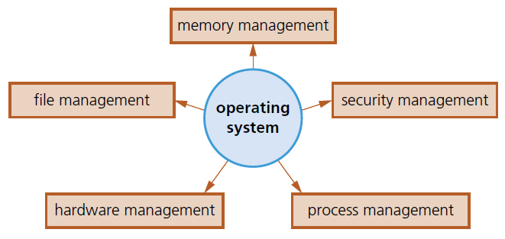
Operating system tasks
The main tasks of file management include defining the file naming conventions which can be used (filename.docx, where the extension can be .bat, .htm, .dbf, .txt, .xls); performing specific tasks, such as create, open, close, delete, rename, copy, move; maintaining the directory structures; ensuring access control mechanisms are maintained; ensuring memory allocation for a file by reading it from the HDD/SSD and loading it into memory.
Memory management is the management of a computer’s main memory. This can be broken down into three parts: memory optimisation, memory organisation and memory protection.
The function of security management is to ensure the integrity, confidentiality and availability of data.
A process is a program which is being run on a computer. Process management involves the allocation of resources and permits the sharing and exchange of data, thus allowing all processes to be fully synchronised (for example, by the scheduling of resources, resolution of software conflicts, use of queues and so on).
The functions of hardware management include communicating with all input and output devices using device drivers; translating data from a file (defined by the operating system) into a format that the input/output device can understand using device drivers; ensuring each hardware resource has a priority so that it can be used and released as required.

Slide 4
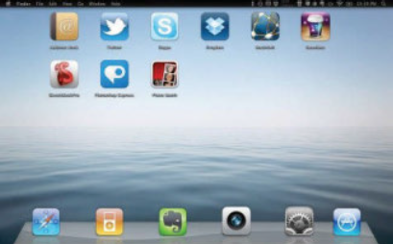
Graphical User Interface
A GUI allows the user to interact with a computer (or MP3 player, gaming device, mobile phone, and so on) using pictures or symbols (icons). Selecting this icon would execute all of the steps shown in the CLI without the need to type them.
GUIs use various technologies and devices to provide the user interface. One of the first commonly used GUI environments was known as windows, icons, menu and pointing device (WIMP), which was developed for use on personal computers (PCs). Here, a mouse is used to control a cursor and icons are selected to open and run windows. Each window contains an application. Modern computer systems allow several windows to be open at the same time.

Slide 5
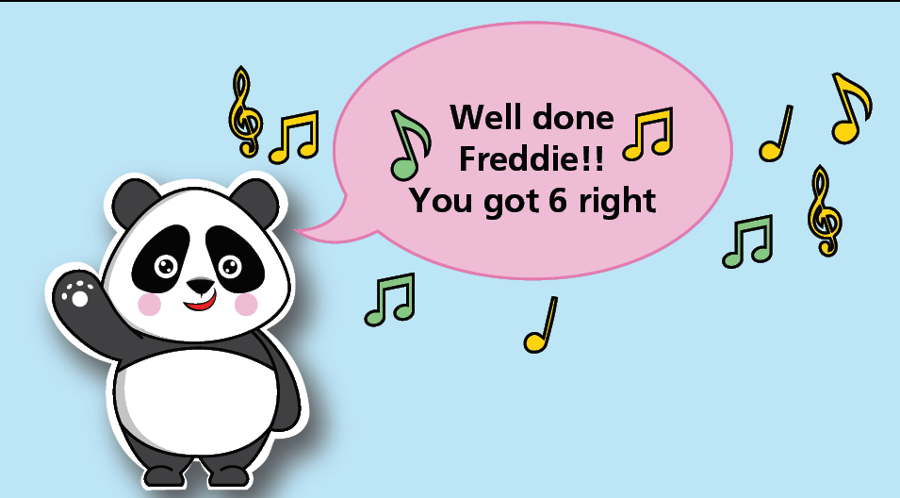
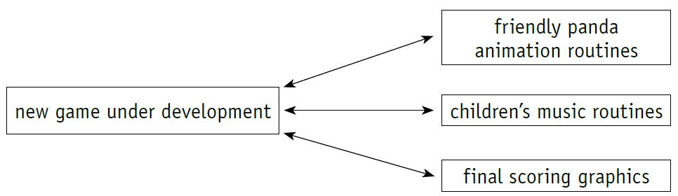
Program Libraries
Program libraries are used
» when software is under development and the programmer can utilise pre-written subroutines in their own programs, thus saving considerable development time
» to help a software developer who wishes to use dynamic link library (DLL) subroutines in their own program, so these subroutines must be available at run time.
Developing software in this way
» removes the need to rewrite the many routines every single time
» leads to modular programming, which means several programmers can be working on the same piece of software at the same time
» allows continuity with other games that may form part of a whole range (in education, where there may be a whole suite of programs, for example)
» allows the maintenance of a ‘corporate image’ in all the software being developed by a particular company
» saves considerable development time having to test each routine, since the routines are all fully tested in other software and should be error-free.
This game could be developed using existing routines from a library.

Slide 6
Command Line Interface
A CLI requires a user to type instructions to choose options from menus, open software, and so on. There are often a number of commands that need to be typed; for example, to save or load a file. The user, therefore, has to learn a number of commands (which must be typed exactly with no errors) just to carry out basic operations. Furthermore, it takes time to key in commands every time an operation has to be carried out.
The advantage of CLI is that the user is in direct communication with the computer and is not restricted to a number of pre-determined options.

Slide 7
Windows Command Prompt
https://www.makeuseof.com/tag/a-beginners-guide-to-the-windows-command-line/
https://www.cs.princeton.edu/courses/archive/spr05/cos126/cmd-prompt.html
Interactive challenge:
https://cmdchallenge.com/
Comprehensive tutorial:
https://www.learnenough.com/command-line-tutorial

Slide 8
Windows Powershell
https://www.varonis.com/blog/windows-powershell-tutorials/
https://www.guru99.com/powershell-tutorial.html
https://powershell-guru.com/

Slide 9
Mac Terminal
https://macpaw.com/how-to/use-terminal-on-mac
https://www.makeuseof.com/tag/beginners-guide-mac-terminal/
https://medium.com/@grace.m.nolan/terminal-for-beginners-e492ba10902a
https://www.macworld.co.uk/how-to/mac-terminal-projects-tutorial-3613813/
https://support.apple.com/en-ca/guide/terminal/apd5265185d-f365-44cb-8b09-71a064a42125/mac

Slide 10
Linux/Unix Server
Linux:
https://linuxcontainers.org/lxd/try-it/
Onlilne Ubuntu Linux Server:
https://www.onworks.net/runos/create-os.html?os=ubuntu-20.04.1-desktop&home=init

